Slide 1
Implementing Domain Driven Design (DDD)
a practical guide

Slide 2
Agenda
Part-I: What is DDD? Why and where we should use it?
Part-II: DDD
Architecture & Layers
Execution Flow
Building Blocks
Common Rules
Part-III: Implementation
Layering a Visual Studio Solution
Building Blocks: Key rules & samples

Slide 3
Part-I: What is DDD?
Why and where we should use it?

Slide 4
What is DDD?

Slide 5
Part-III: DDD
DDD Architecture & Building Blocks

Slide 6
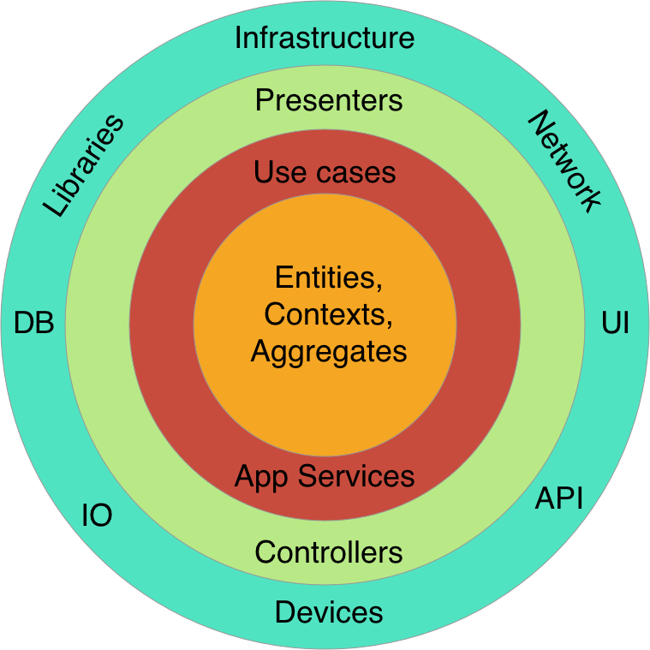
Domain Driven Design Layers / Clean Architecture
Infrastructure
Layer
Presentation Layer
Application Layer
Domain Layer

Slide 7

Domain Driven Design Execution Flow
PRESENTATION layer
APPLICATION layer
DOMAIN layer
HTTP request
Entities
Browsers
MVC UI
DTO
html/js/css
Application
Services
Domain Services
HTTP request
Remote clients
HTTP API
DTO
Repositories (interface)
JSON
Distributed Services
Layer
Exception Handling
Audit Logging
Caching
Authorization
Validation
Authorization
Validation
Unit of Work / DB Transaction
C r o s s C u t t i n g C o n c e r n s

Slide 8
Domain Driven Design Core building Blocks
Domain Layer
Entity
Aggregate Root
Value Object
Repository
Domain Service
Specification
Domain Events
Application Layer
Application Service
Data Transfer Object (DTO)
Unit of Work

Slide 9
Domain Driven Design Common Rules
Database / ORM independence
Presentation technology agnostic
Doesn’t care about reporting / mass querying
Focuses on state changes of domain objects
…TODO

Slide 10
Part-III: Implementation
Implementing Domain Driven Design (DDD)

Slide 11
Aggregate Roots Principles
Should maintain self integrity & validity
Implements domain rules
Saved & retrieved as a single unit (with sub-collections)
TODO: Show a picture of an aggregate with a root & collections

Slide 12
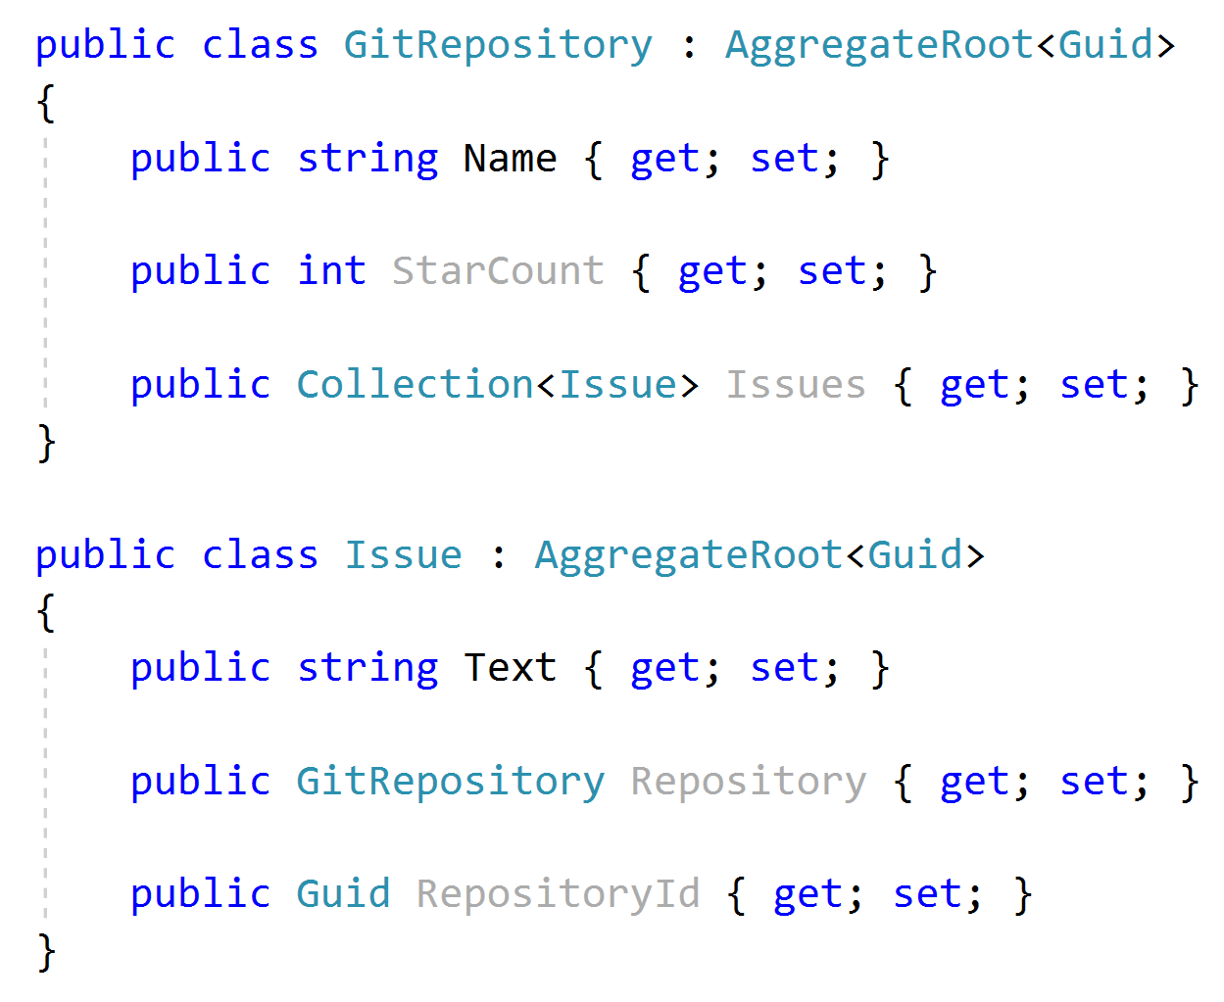


Aggregate Roots Rule: Reference other aggregates by Id

Slide 13
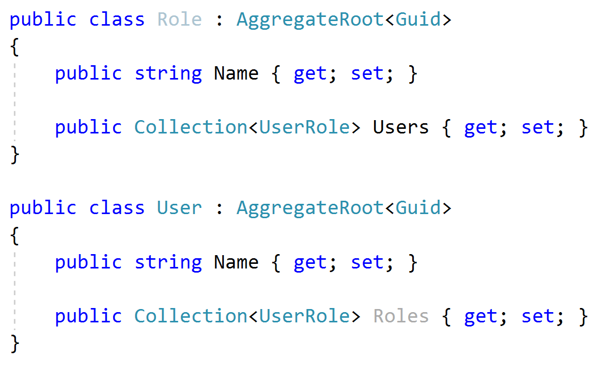
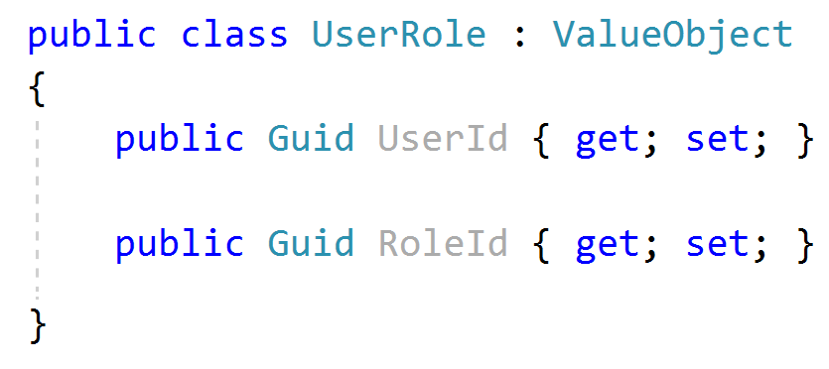
Aggregate Roots Tip: Keep it small
Considerations;
Query Performance
Data Integrity & Validity
Should be serializable (required for NoSQL databases)

Slide 14
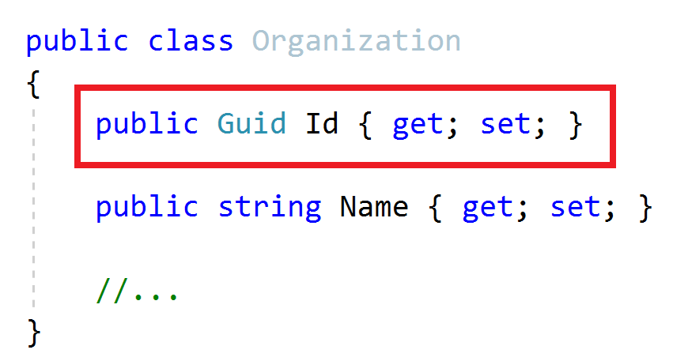
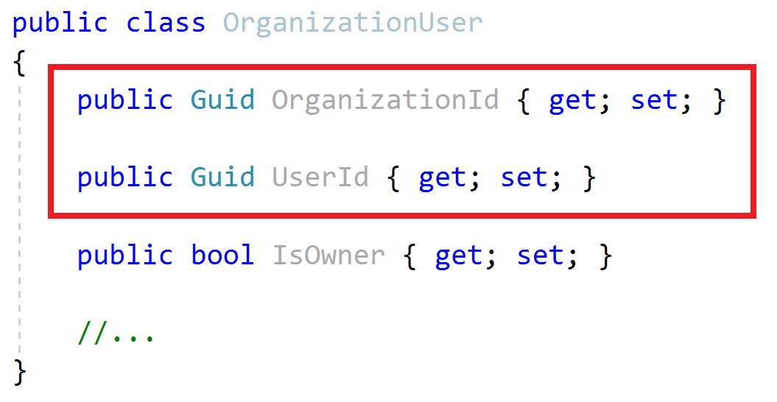
Aggregate Roots / Entities Primary Keys
Aggregate Root
Entity
Define a single Primary Key (Id)
Define a composite Primary Key
Suggestion: Prefer GUID as the PK

Slide 15
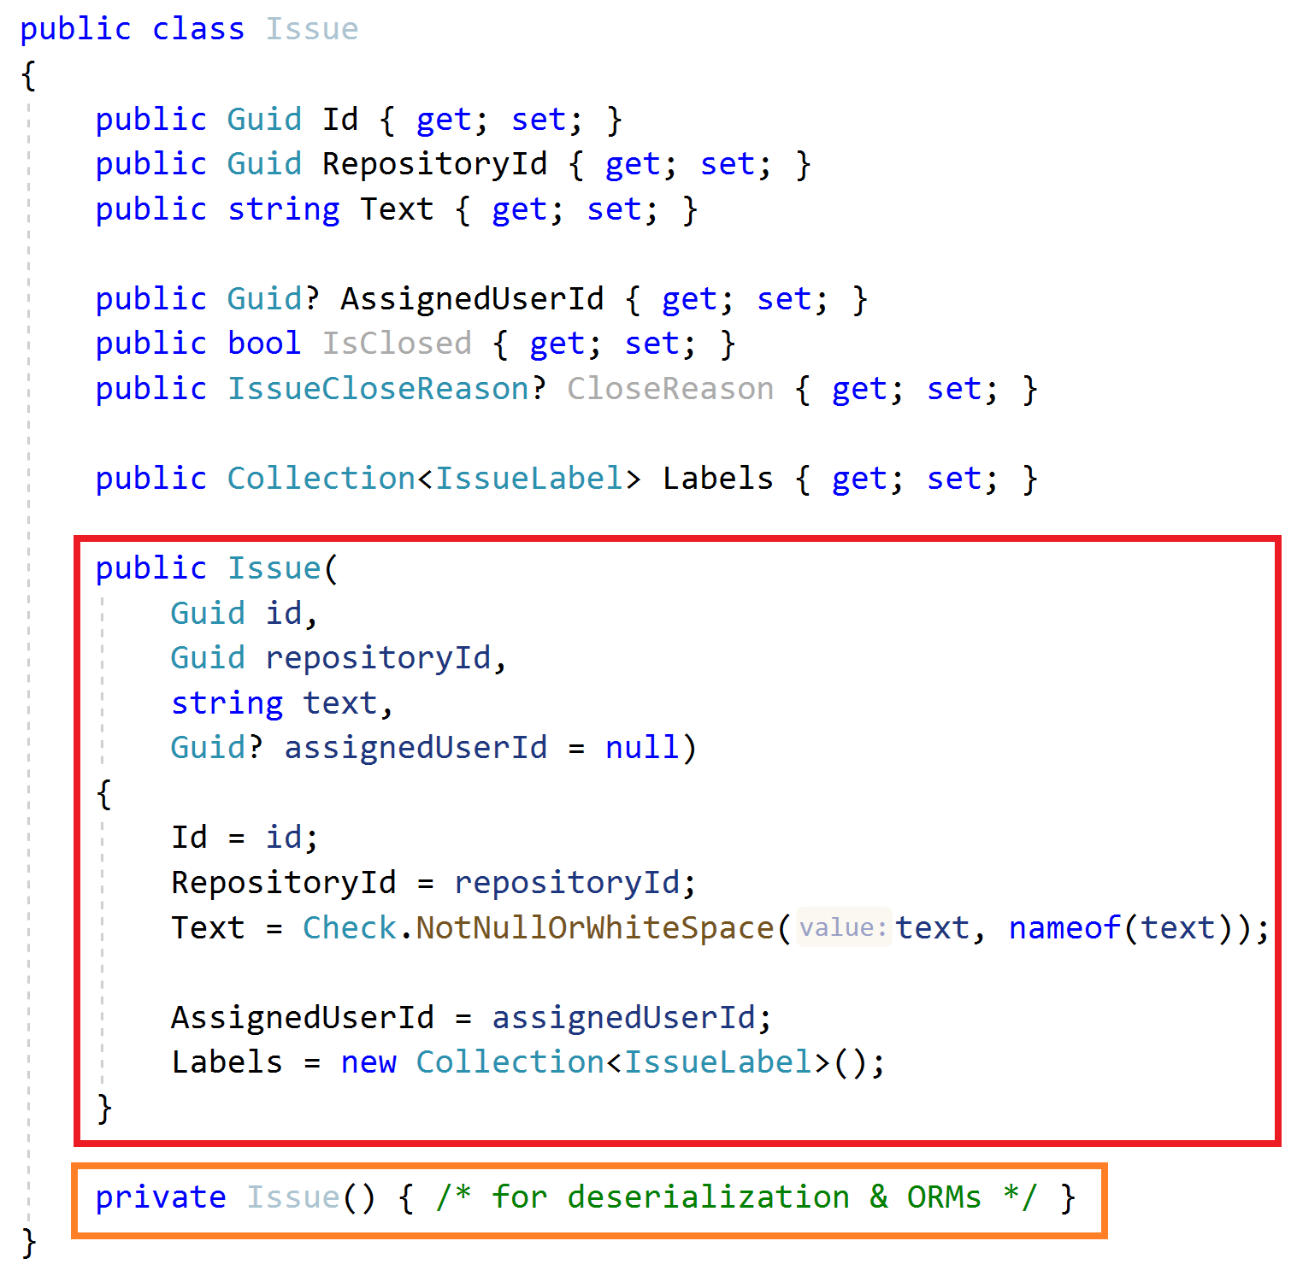
Aggregate Roots / Entities Constructor
Force to create a VALID entity
Get minimum required arguments
Initialize sub collections
Get id as an argument (don’t use Guid.NewGuid())
Use a service to create GUIDs, like IGuidGenerator
Create a private default constructor for ORMs & deserialization

Slide 16
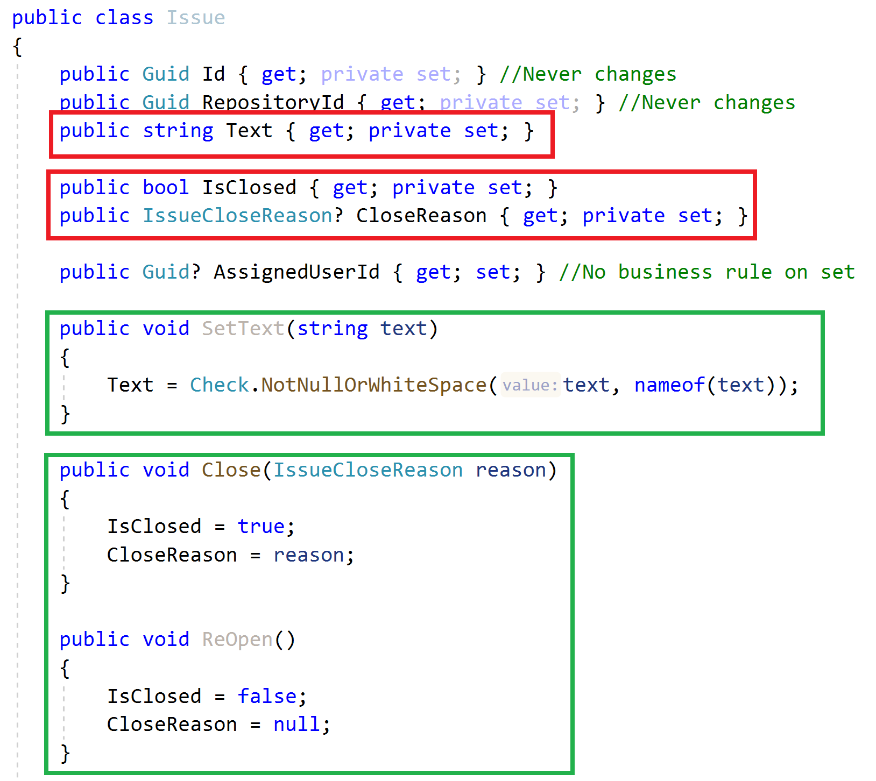
Aggregate Roots / Entities Property Accessors / Methods
Maintain object VALIDITY
Use private setters
Change properties via methods

Slide 17
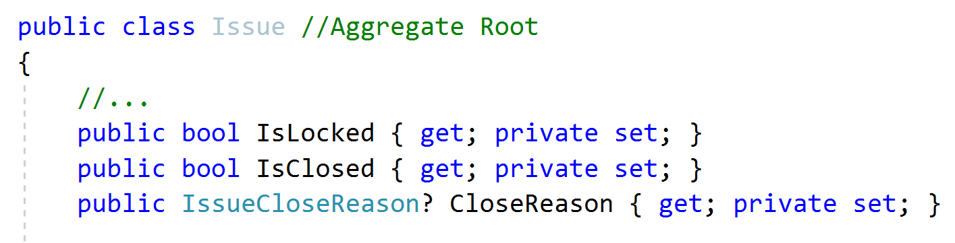
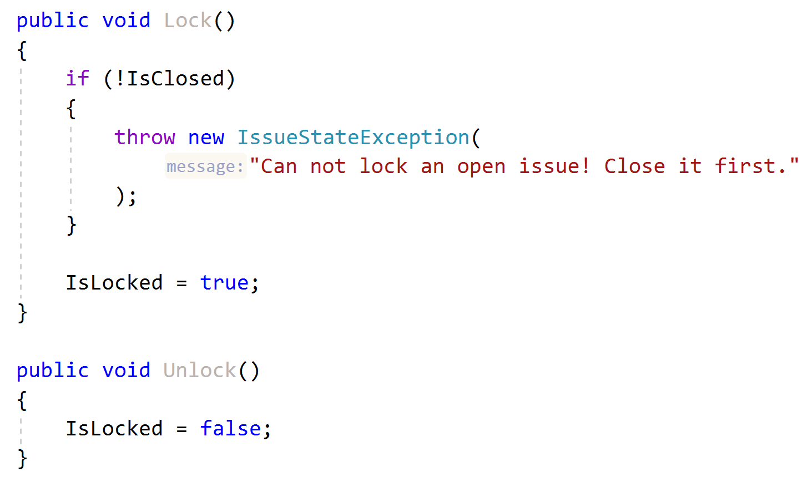
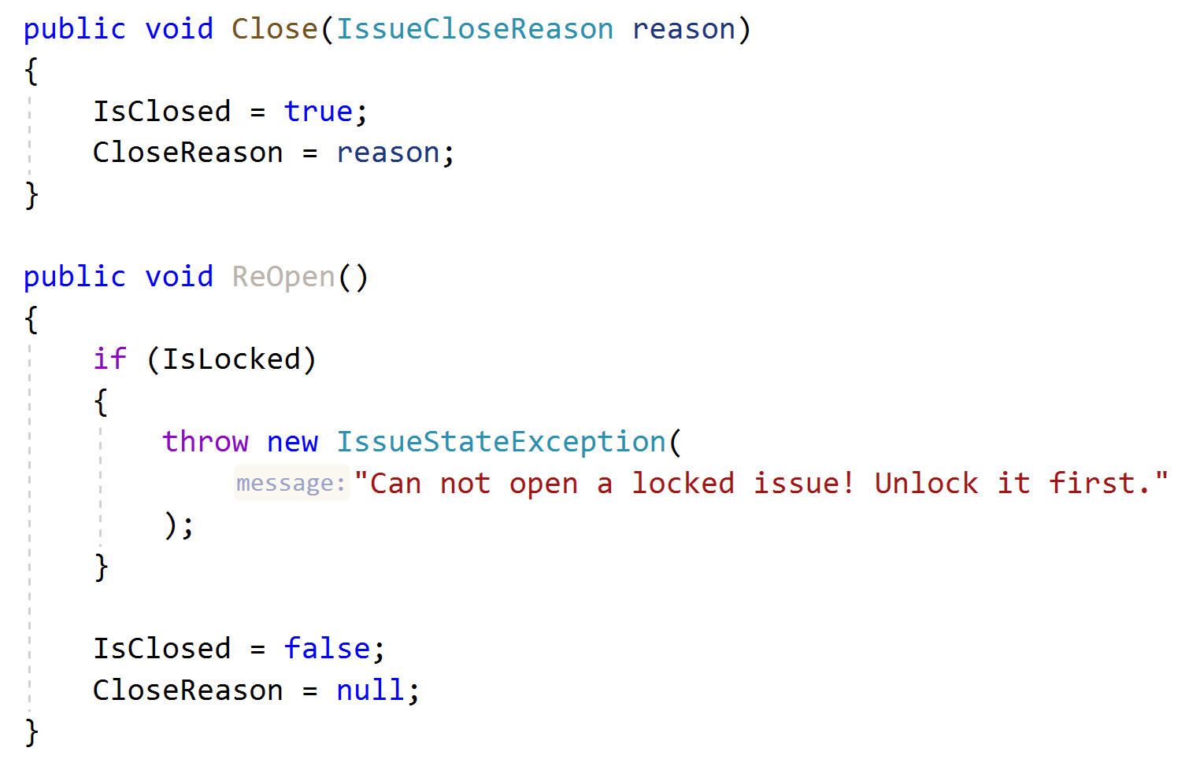
Aggregate Roots / Entities Business Logic & Exceptions
Implement Business Rules
Define a good method name matches to the domain action
Define and throw specialized exceptions

Slide 18
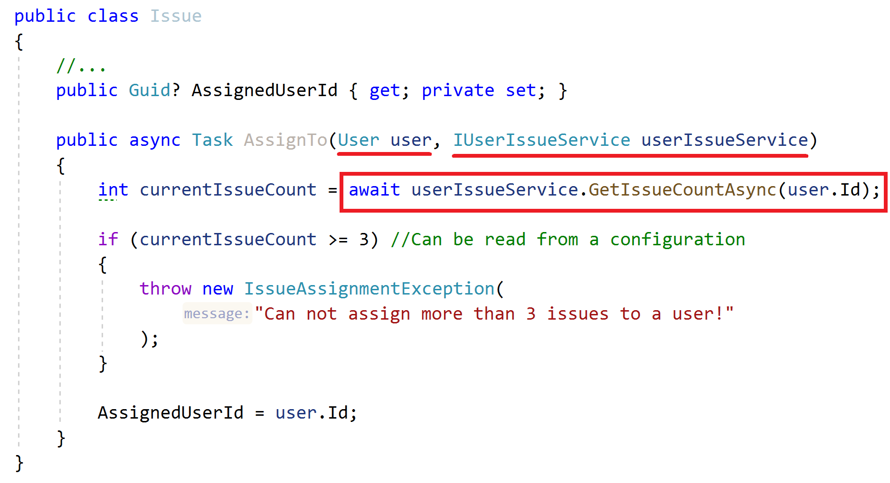
Aggregate Roots / Entities Business Logic
How to implement when you need external services?
Business Rule: Can not assign more than 3 issues to a user!

Slide 19
Aggregate Roots / Entities Business Logic
How to implement when you need external services?
Business Rule: Can not assign more than 3 issues to a user!
ALTERNATIVE..?
Create a Domain Service!

Slide 20
Repositories Principles
Define interface in the domain layer, implement in the infrastructure
Do not include domain logic
Repository interface should be database provider / ORM independent
Create repositories for aggregate roots, not entities

Slide 21
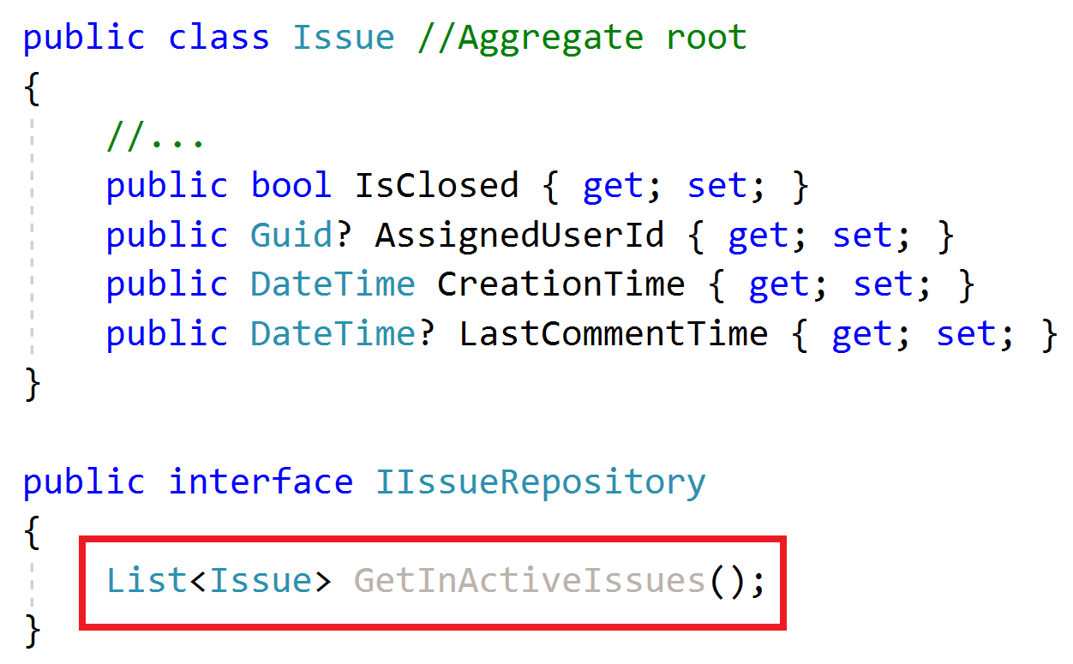
Repositories Do not include domain logic
What is an In-Active issue?

Slide 22
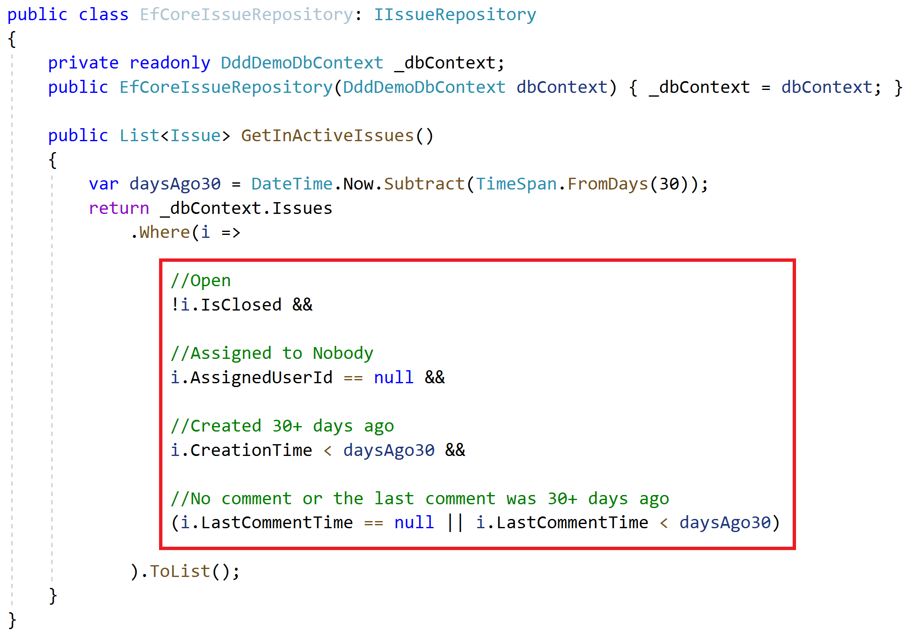
Repositories Do not include domain logic
Implicit definition of a domain rule!
How to re-use this expression? Copy/paste?

Slide 23
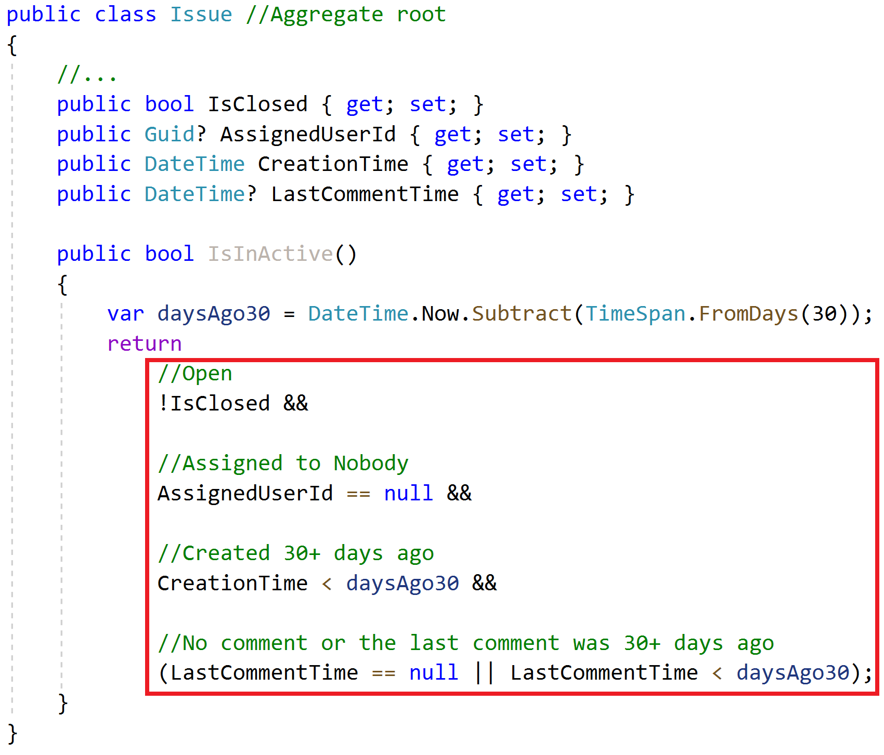
Repositories Do not include domain logic
Implicit definition of a domain rule!
How to re-use this expression? Copy/paste?
Solution: The Specification Pattern!

Slide 24
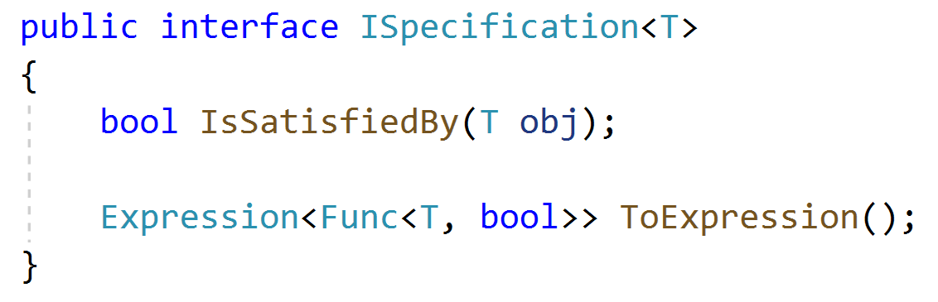
Specifications
A named, reusable & combinable class to filter objects.

Slide 25
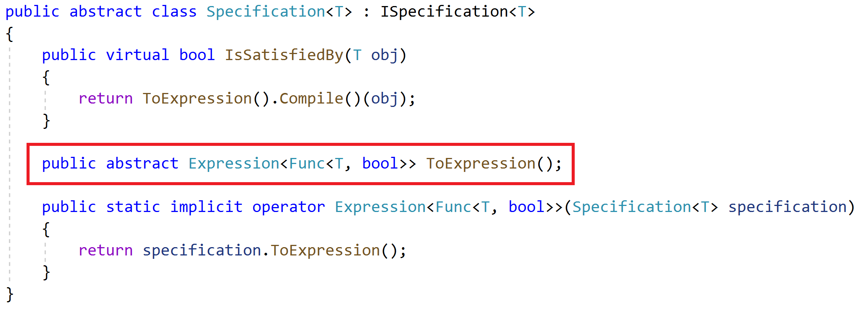
Specifications
A named, reusable & combinable class to filter objects.

Slide 26
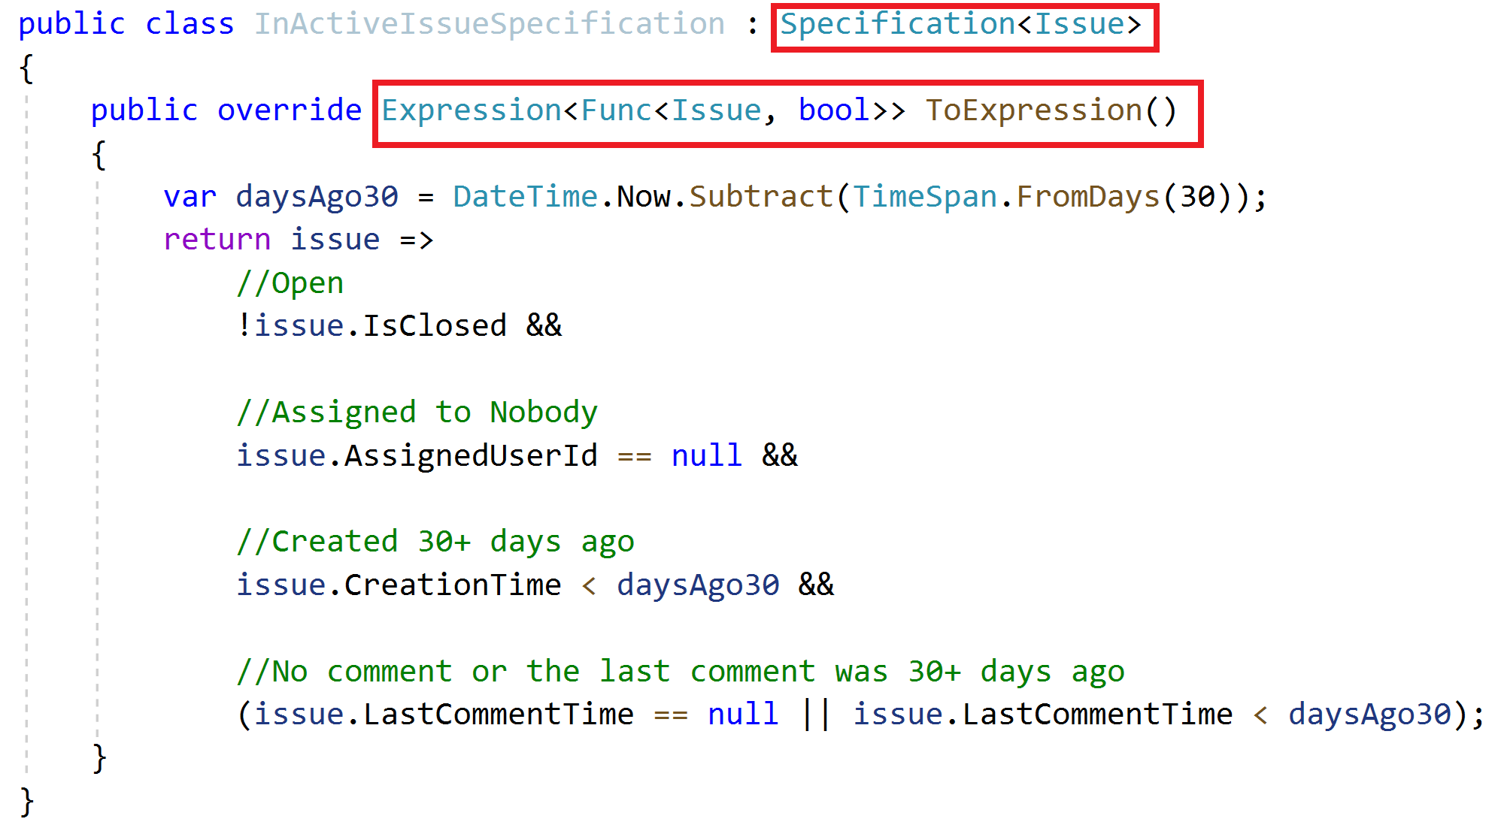
Specifications Define a specification

Slide 27
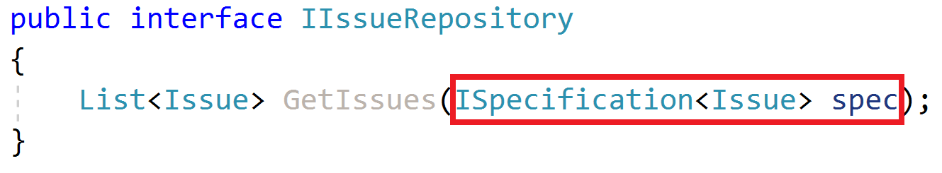
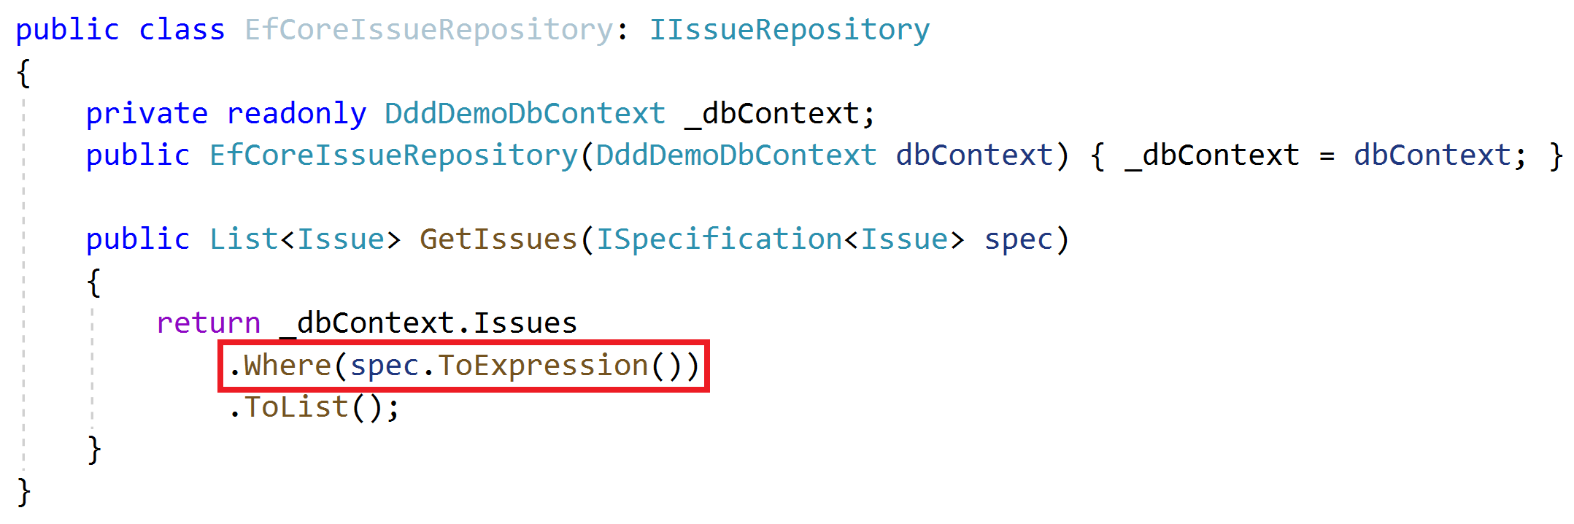
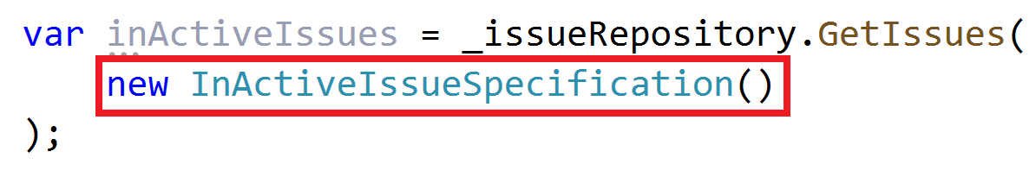
Specifications Use the specification

Slide 28
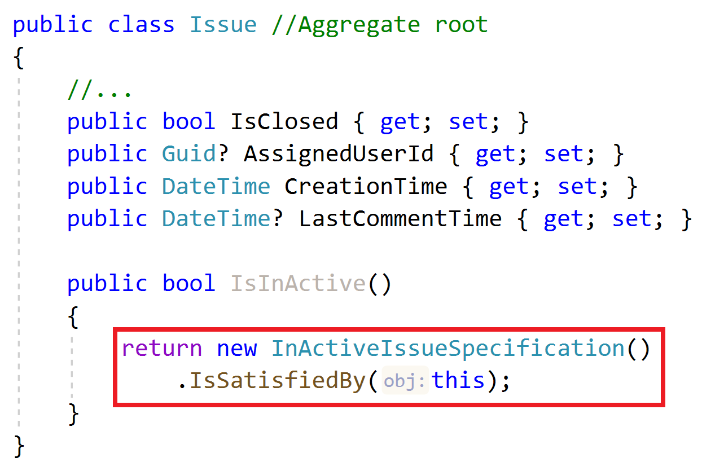
Specifications Use the specification

Slide 29
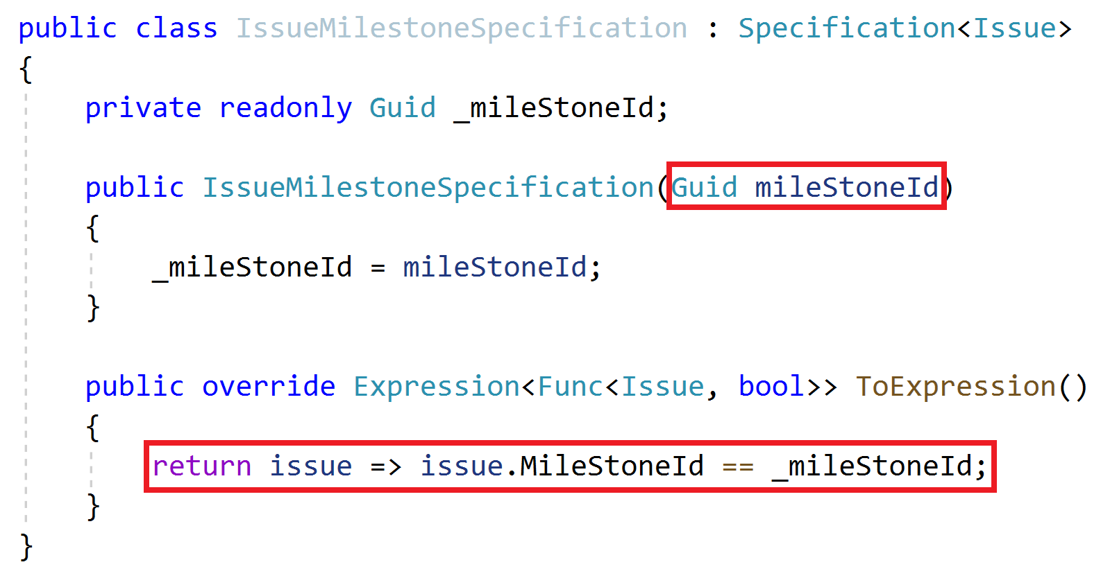
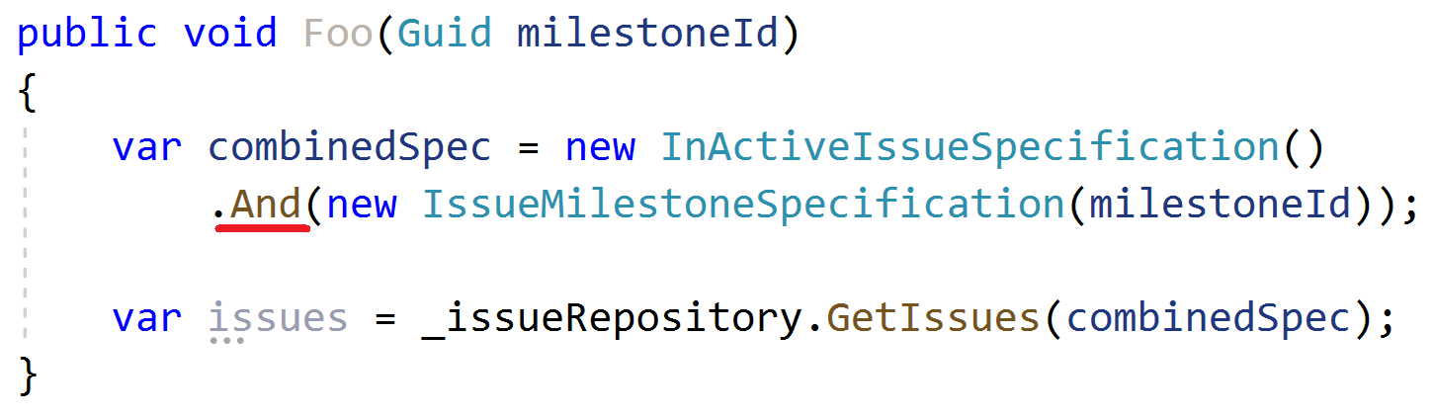
Specifications Combining Specifications

Slide 30
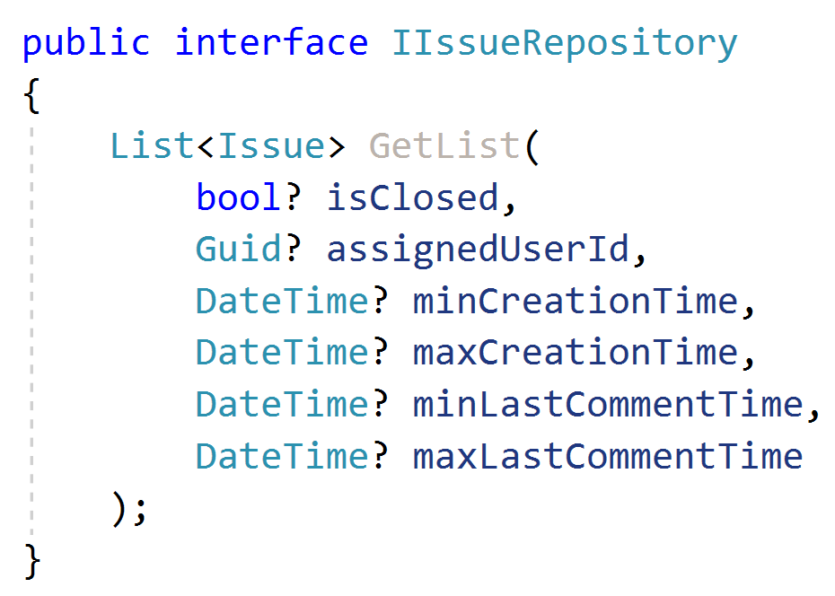
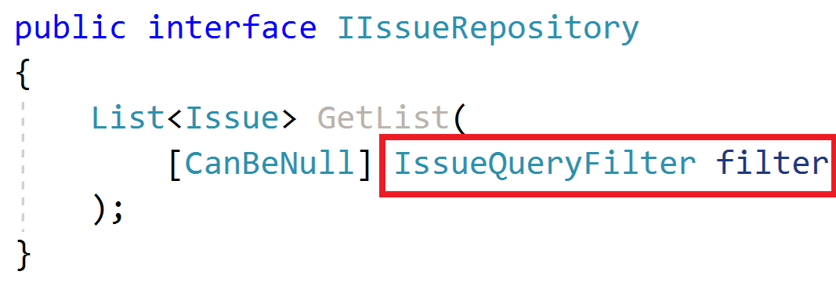
Repositories Querying

Slide 31
Repositories Querying / Read Models
Read model: A special entity-like class to read data from the database.
Minimize read models, do not use for single-entity operations
Define & use read models only in performance critical parts
TODO: Example
Do not reuse aggregate roots or entities inside read models
TODO: Example (UserWithRole, SimpleUser, DetailedUser… etc.)

Slide 32
Repositories Querying / Read Models
TODO…

Slide 33
Domain Services Principles
Implements domain logic;
Depends on services/repositories
Needs to work with multiple entities / entity types
Create for aggregate roots, not for entities
Work with domain objects, not DTOs

Slide 34
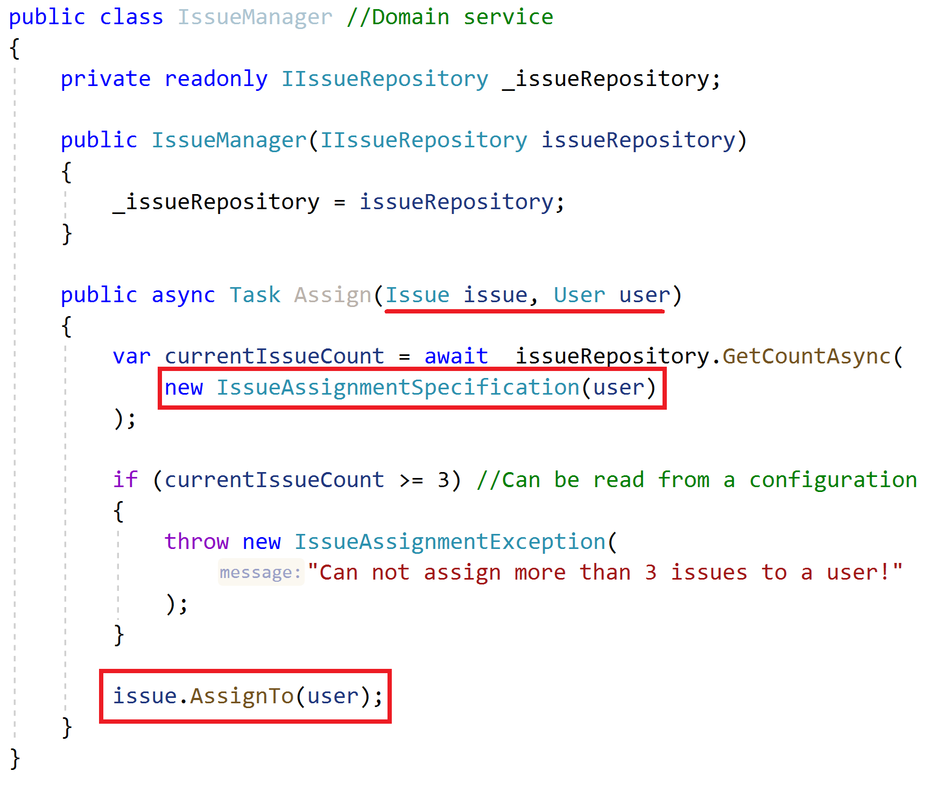
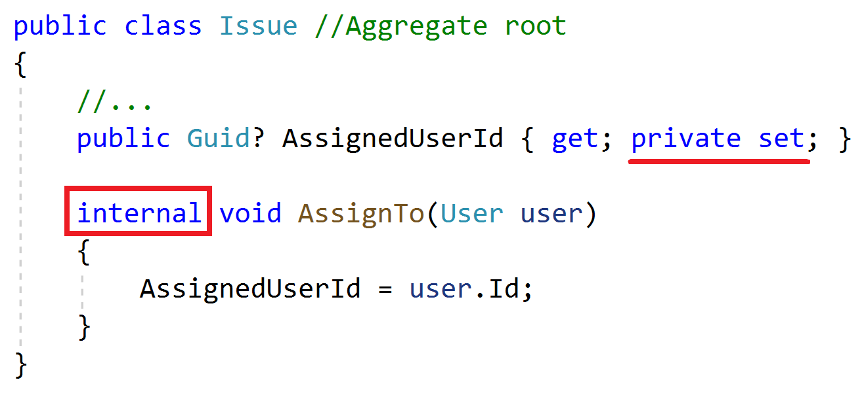
Domain Services Example

Slide 35
Domain Services More…
TODO

Slide 36
Application Services Principles
Implement use cases of the application (application logic), not domain logic!
Get & return Data Transfer Objects, not entities!
Use entities, repositories and other domain objects inside

Slide 37
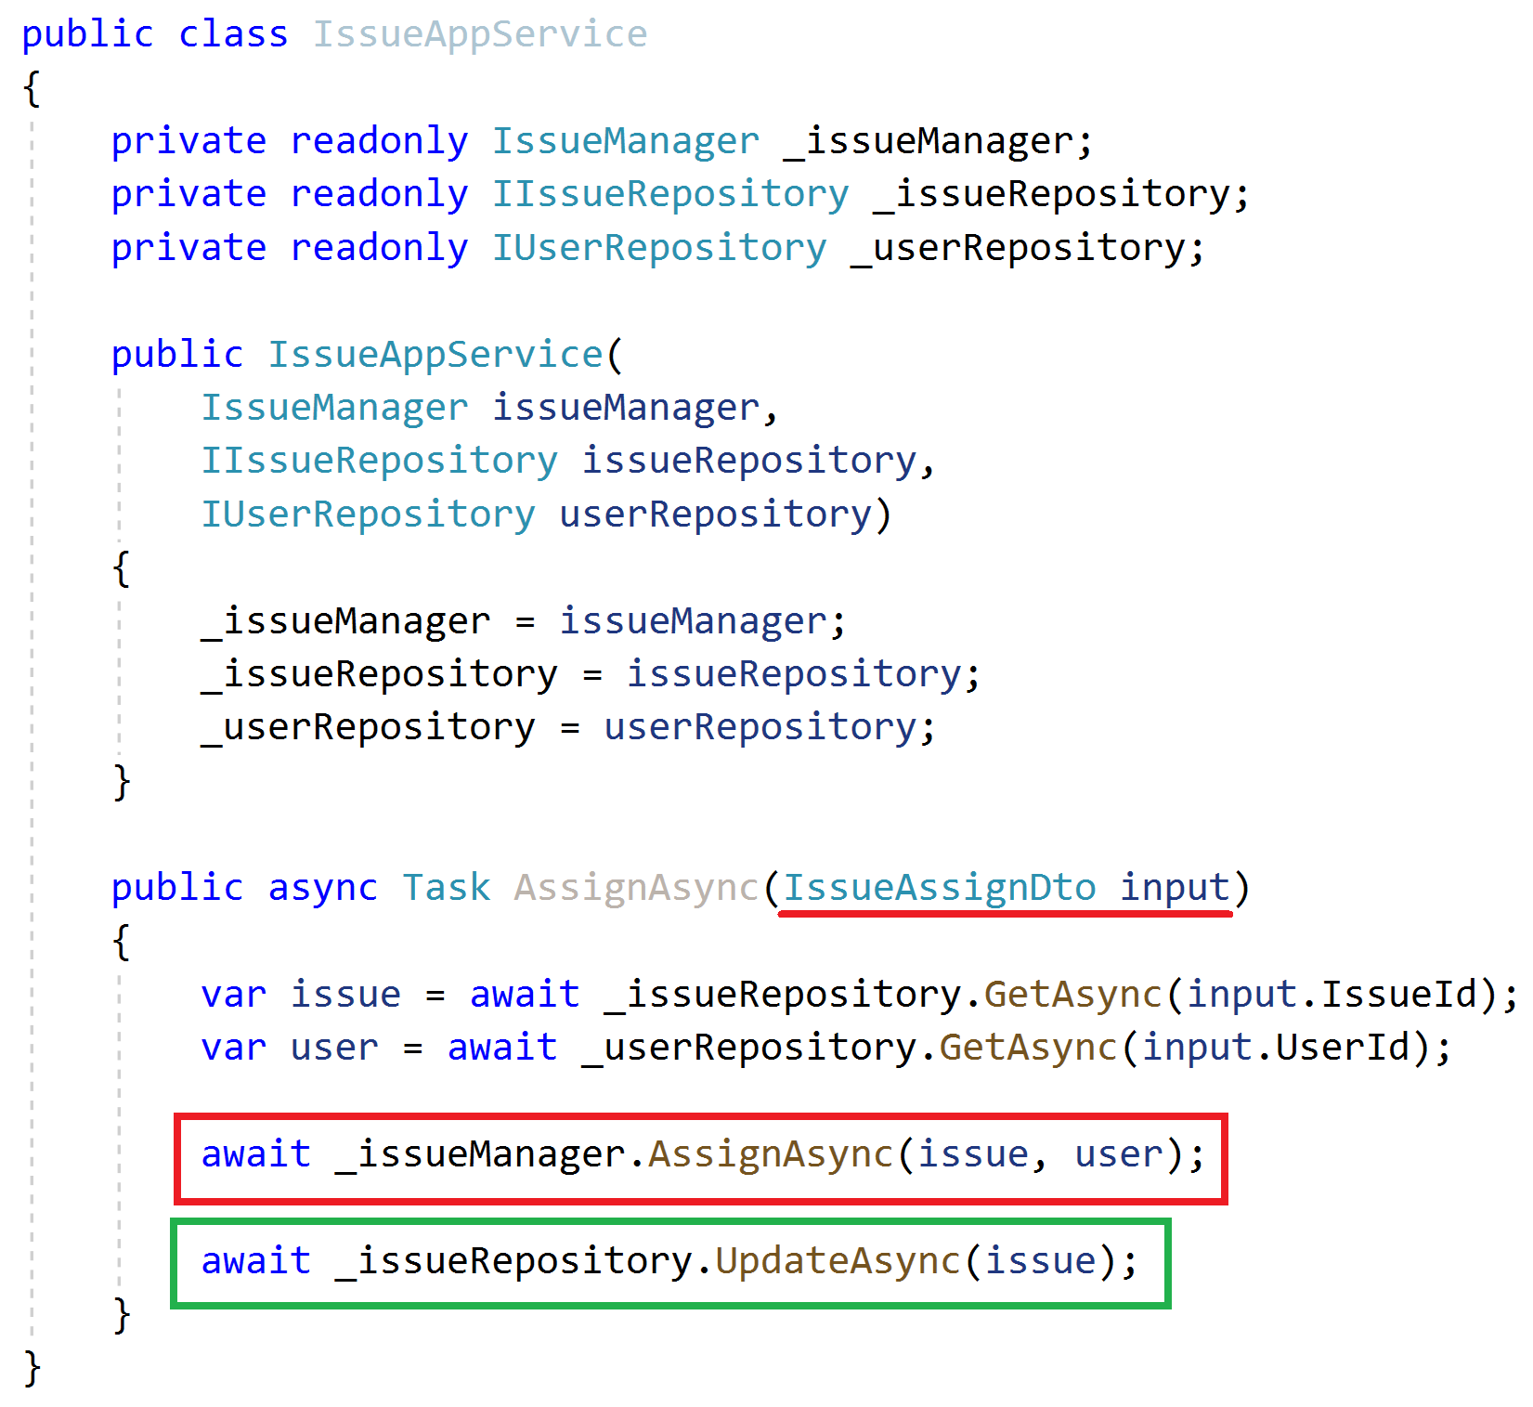
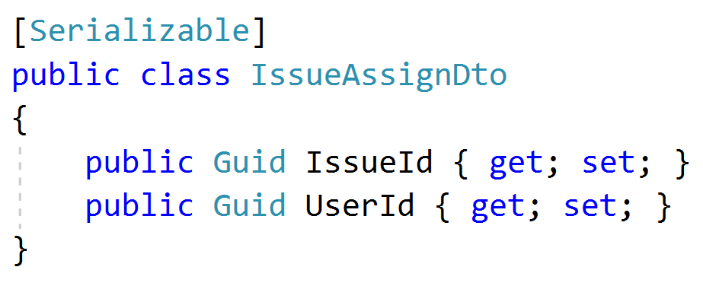
Application Services Example
Inject domain services & repositories
Get DTO as argument
Get aggregate roots from repositories
Use domain service to perform the domain logic
Always update the entity explicitly (don’t assume the change tracking)

Slide 38
Application Services Common DTO best practices
Should be serializable
Should have a parameterless public constructor (implicit/explicit)
Should not contain any business logic
Never inherit from entities! Never reference to entities!

Slide 39
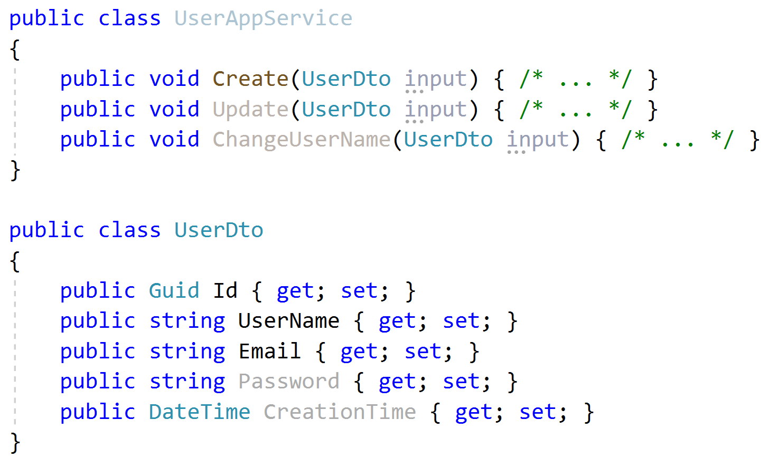
Application Services Input DTO best practices
Define only the properties needed for the use case
Do not reuse same input DTO for multiple use cases (service methods)
Id is not used in create! Do not share same DTO for create & update!
Password is not used in Update and ChangeUserName!
CreationTime should not sent by the client!

Slide 40
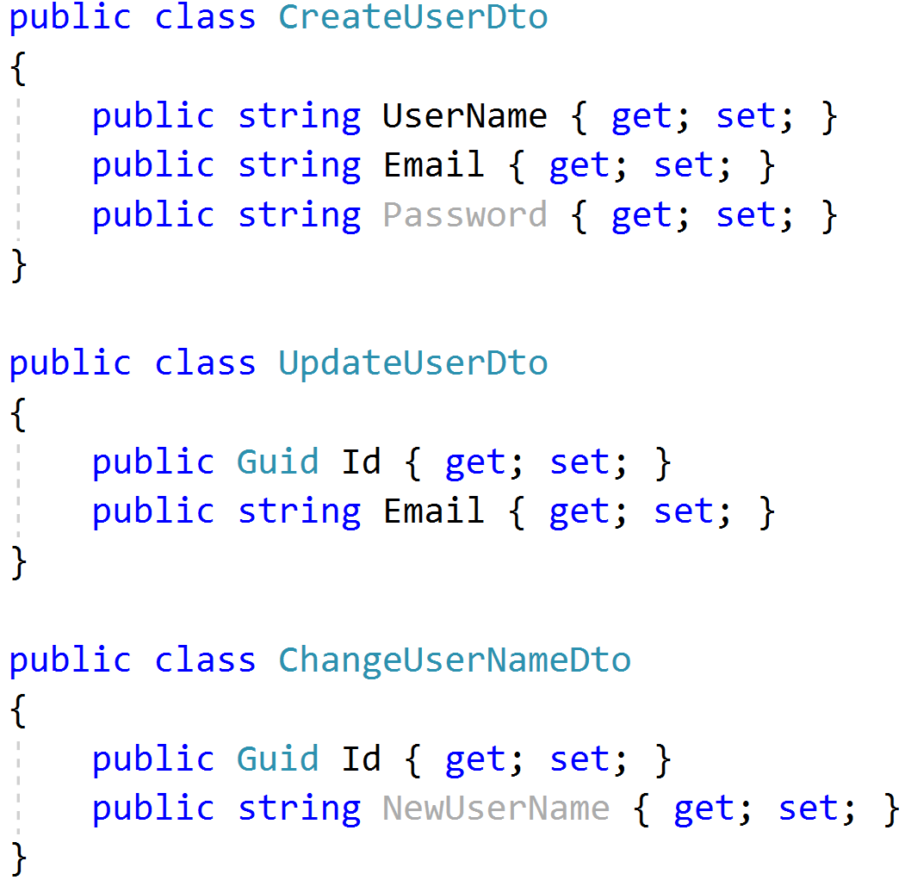
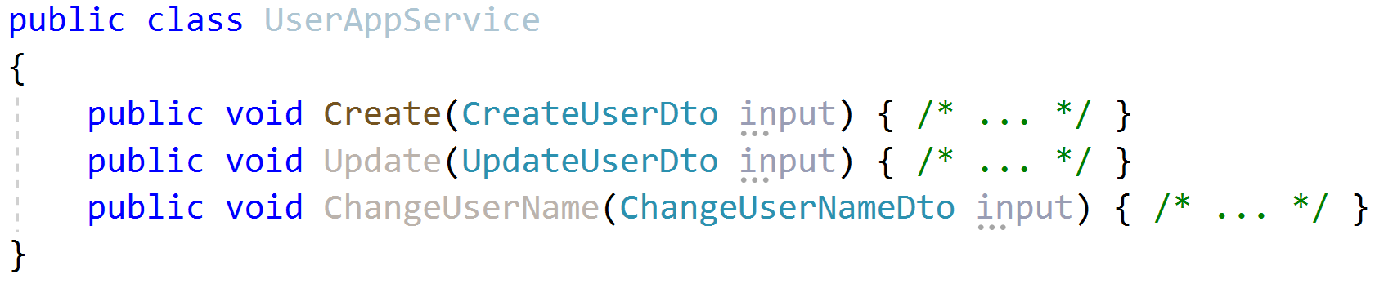
Application Services Input DTO best practices
Define only the properties needed for the use case
Do not reuse same input DTO for multiple use cases (service methods)

Slide 41
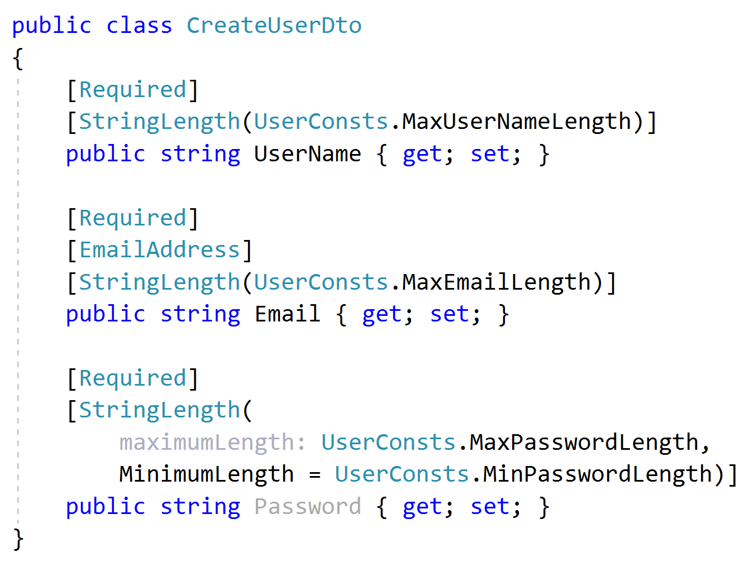
Application Services Input DTO best practices
Implement only the formal validation (can use data annotation attributes)
Don’t include domain validation logic (ex: unique user name constraint)

Slide 42
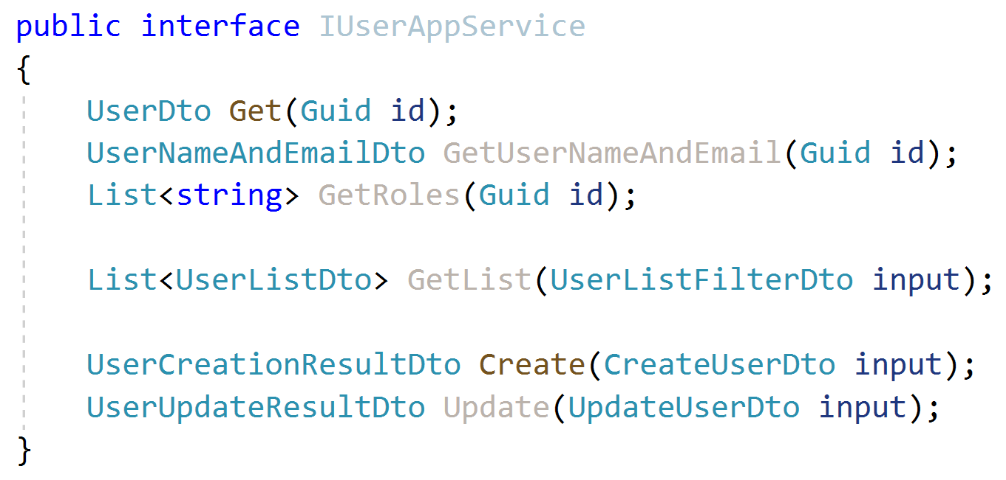
Application Services Output DTO suggestions
Keep output DTO count minimum. Reuse where possible (except input DTOs as output DTO).
Return the entity DTO from Create & update methods.
Can contain more data than client needs
Exception: Where performance is critical, especially for large result sets.

Slide 43
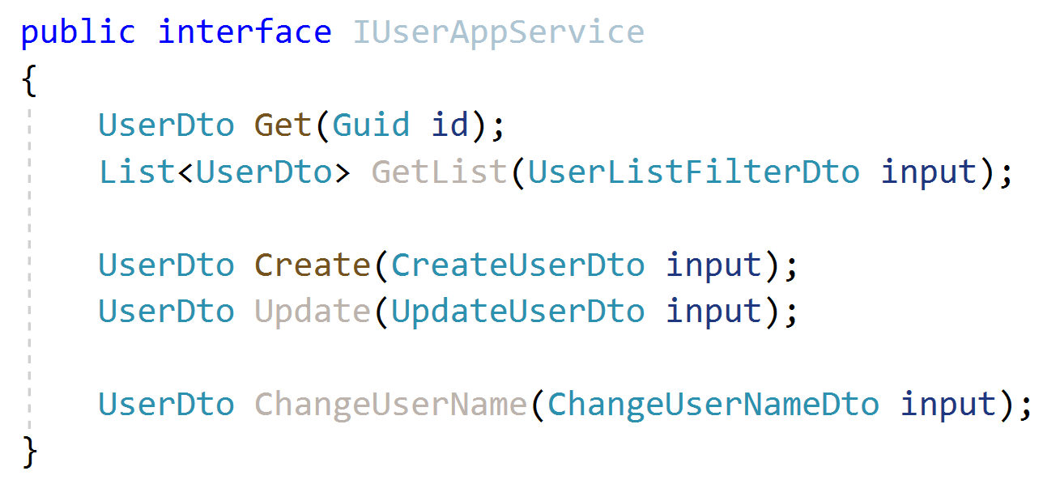
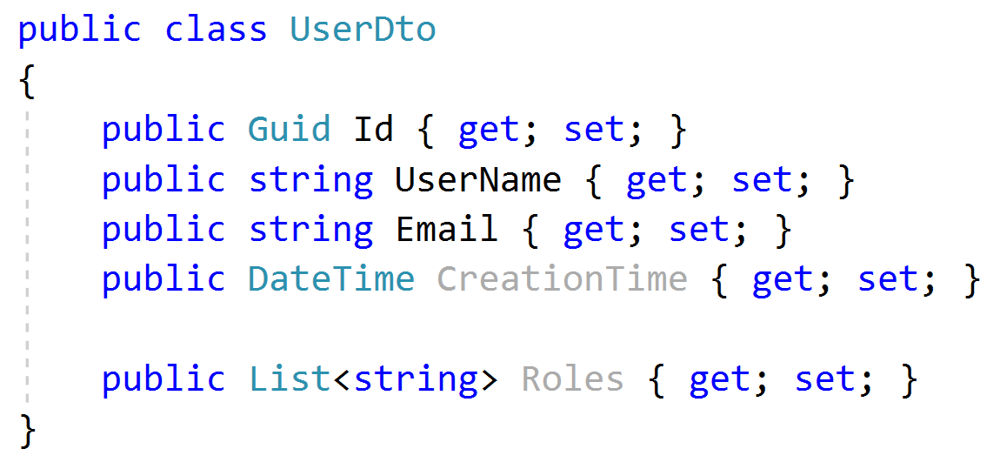
Application Services Output DTO suggestions
Keep output DTO count minimum. Reuse where possible (except input DTOs as output DTO).
Return the entity DTO from Create & update methods.
Can contain more data than client needs
Exception: Where performance is critical, especially for large result sets.

Slide 44
Application Services Object to Object Mapping
Use auto object mapping libraries (but, carefully – enable configuration validation)
Do not map input DTOs to entities. Map entities to output DTOs

Slide 45
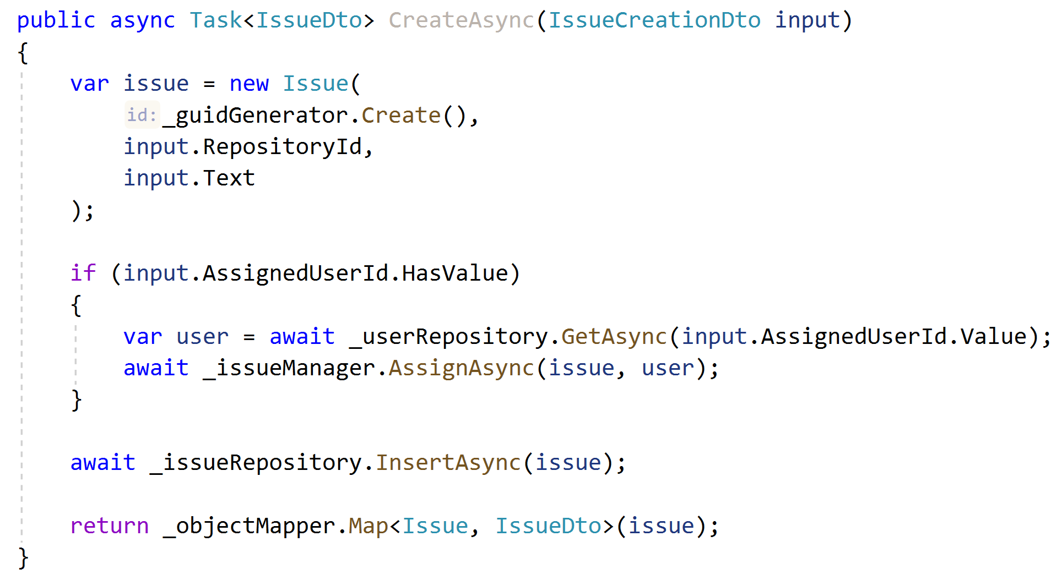
Application Services Example: Entity Creation
Don’t use DTO to entity auto-mapping, use entity constructor.
Perform additional domain actions.
Use repository.
Return DTO using auto-mapping.

Slide 46
Domain/Business Exceptions
Do not return null or operation result code for exceptional cases, throw exceptions!
Define exception classes for important business rules
Include an error code in the exception
Separate localization from exception throwing
Map exceptions to HTTP status codes

Slide 47
Domain/Business Exceptions

